Slide 1

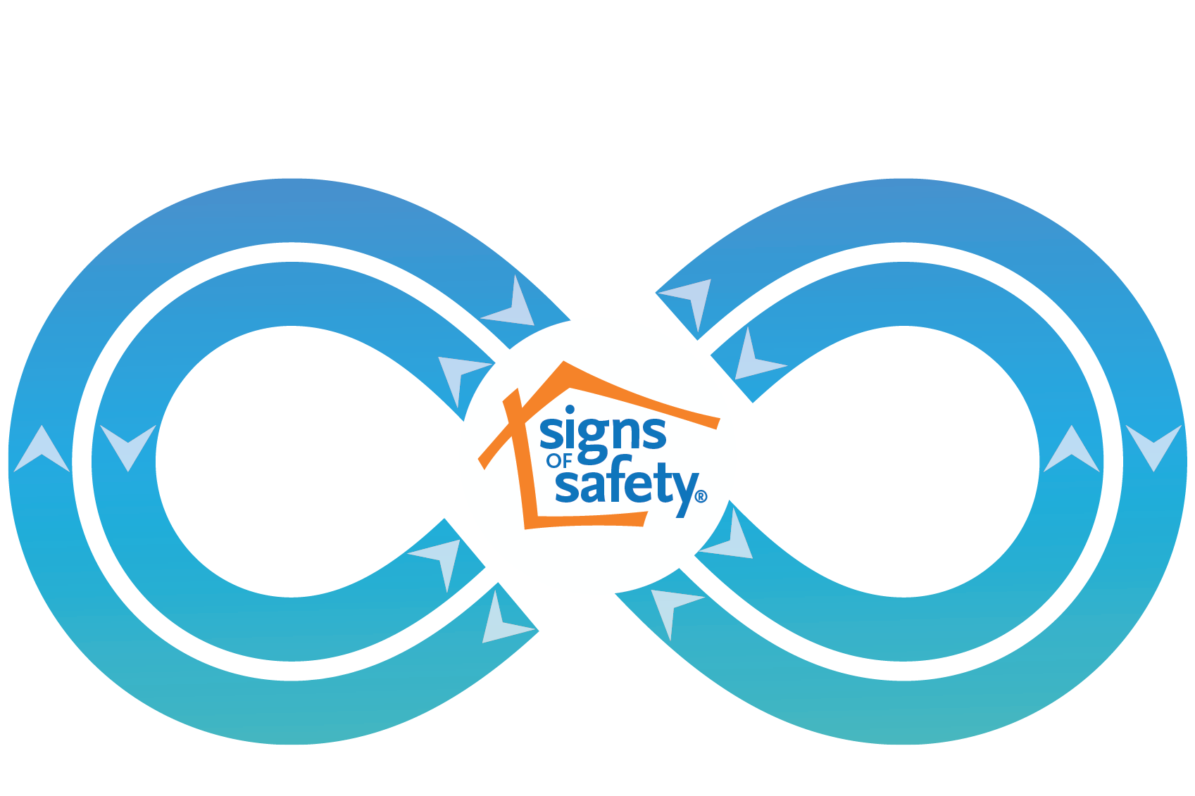
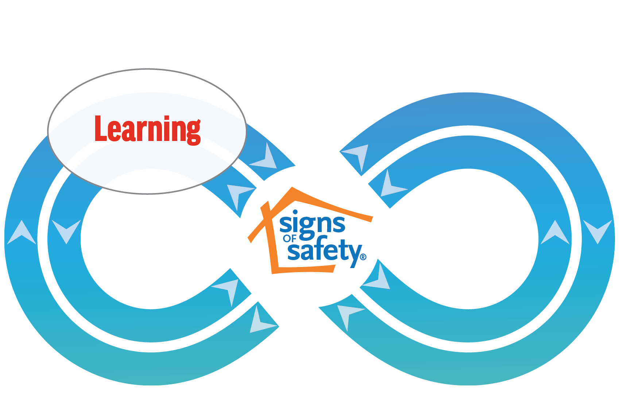
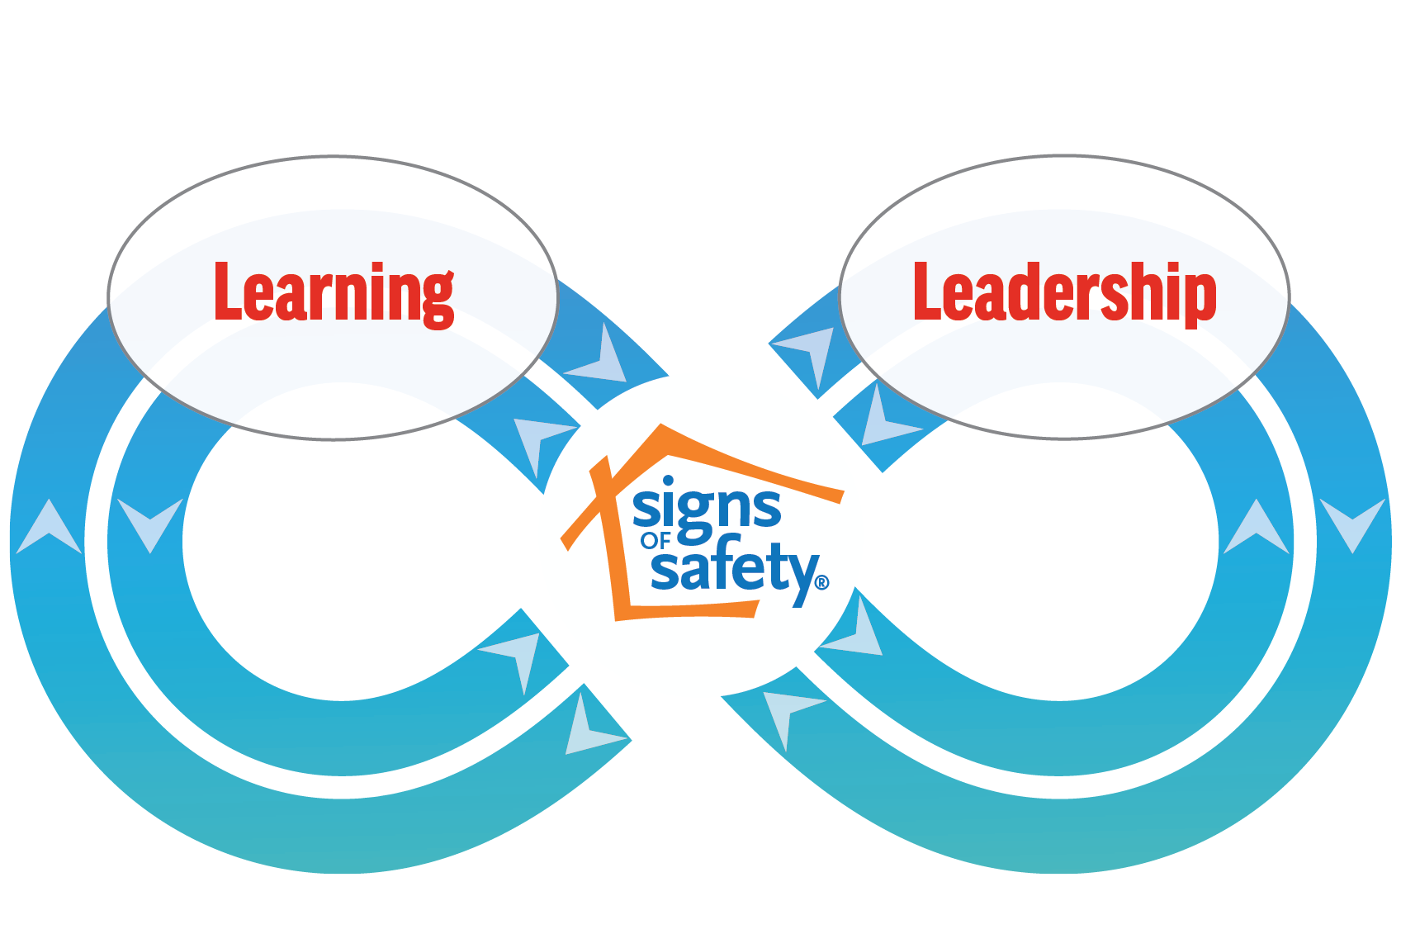
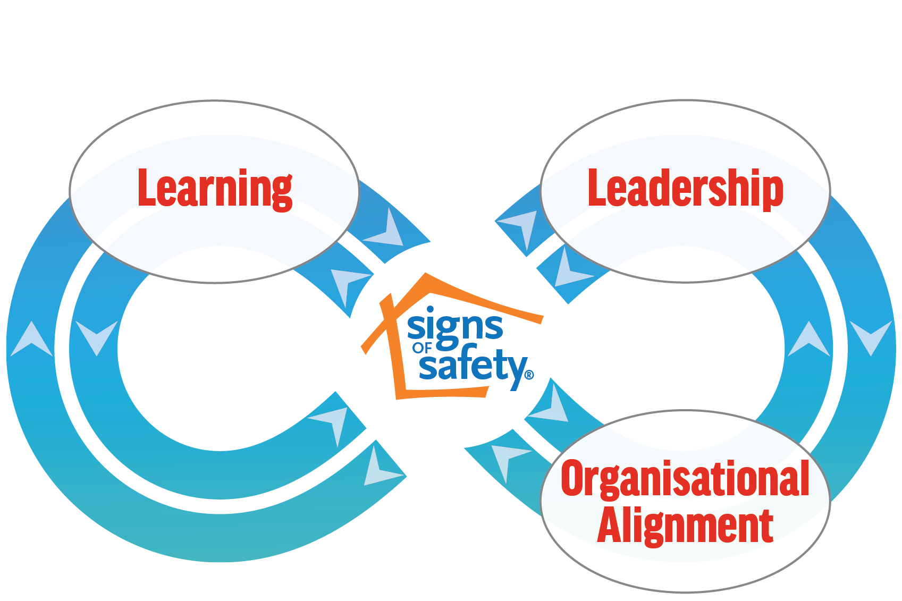
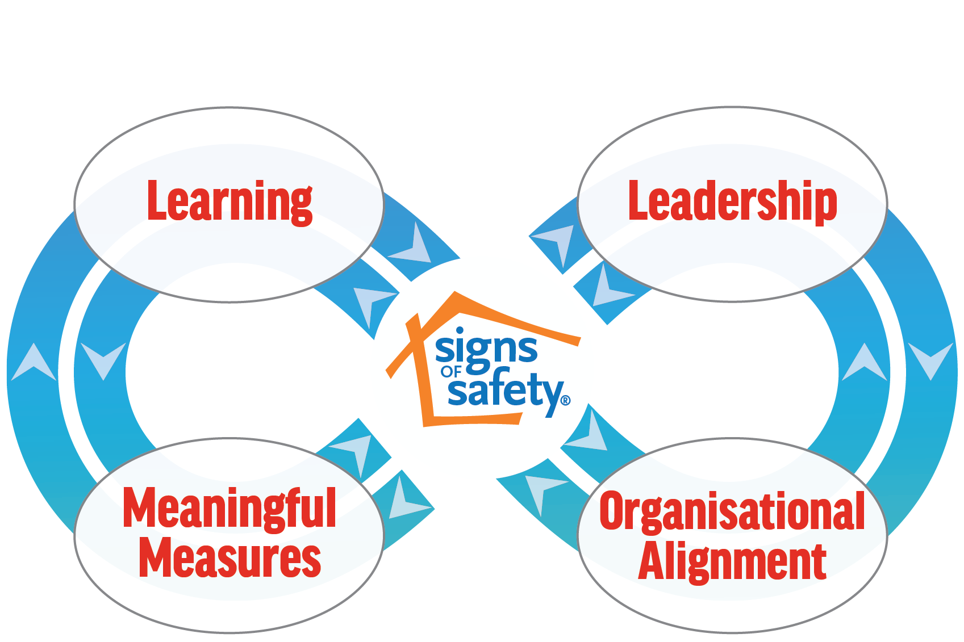
• Clear, explicit
commitment and engagement with the
Implementation
Mission Critical Implementation
• Core training and coaching (basic, advanced, targeted, and learning
and development
trajectory for practice leaders)
A roadmap of 8 key parts
• Modelling the Signs of Safety in leadership and connection to practice (leadership development trajectory)
• Signs of Safety
learning methods in the workplace (group supervision, appreciative inquiry)
• Case management workflow and processes fitting the Signs of Safety practice (informed by whole system learning cases and driven by practice intensives at workflow stages)
• Aligned QA measuring the practice — breadth (by dashboard), depth (by collaborative review) and impact (by core data) — and through feedback surveys of children and young people, families and staff; with action learning cycles
• Aligning the IT system over the short and long term
Preparation - six to twelve months
Intense implementation - two to three years
Five-year commitment to implementation activity Continuous development beyond
• Partners engaged to understand and work with Signs of Safety

